Slide 1









Instruction
You are on planet earth and using one of the two spaceships can get to nearby planets
Each of these planets have a portal on them that takes you to extragalactic planets where
you will collect some money . You will take this journey on a number of times and the money you collect will add to your overall money reward.
* Sometimes you will start your journey from the planet and go through the portal to aliens vaults without choosing a spaceship.

Slide 2
Here is how this universe works
1) You choose your spaceship which takes you to one of the planets
2) From the planets the portal takes you to aliens’ vaults
OR
3) The vaults will contain money which you will collect
OR

Slide 3
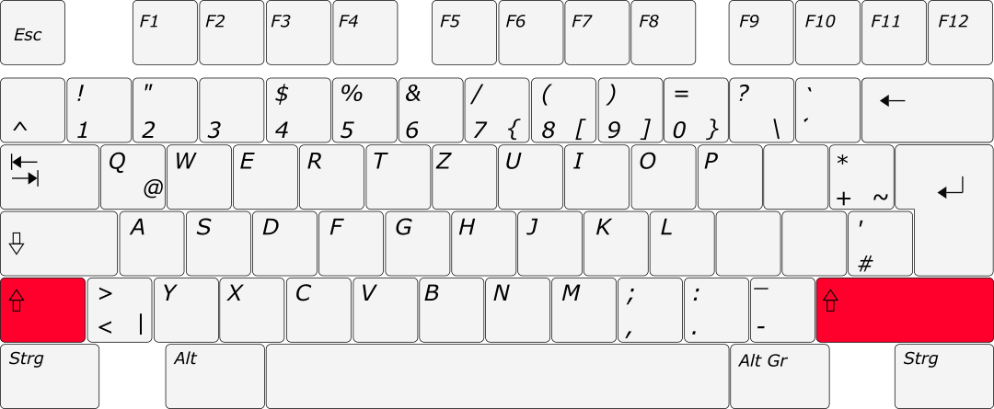
Trial: 1
Step 1:
Choose the spaceship using shift keys
Choose your spaceship using shift keys

Slide 4
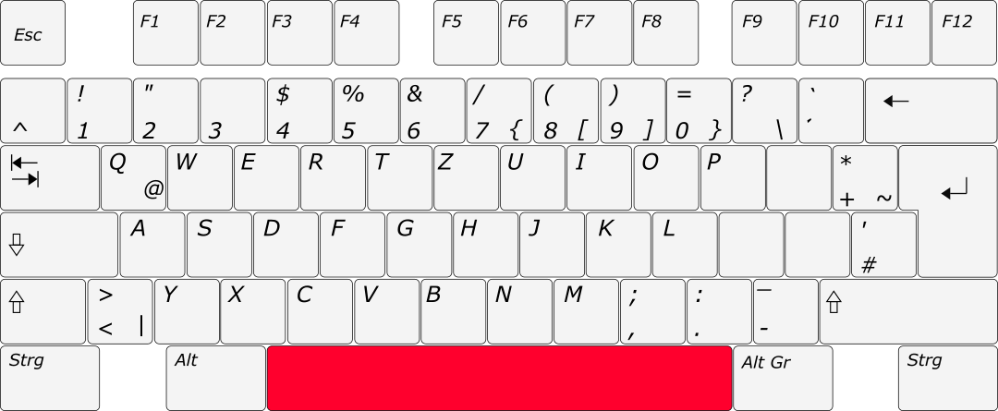
Trial: 1
Step 2:
Reach the planet, press space bar to use to portal
Press space bar to continue

Slide 5
Trial: 1
Step 3:
Reach the extragalactic planet, press space bar to collect the money and continue
0.08 £
Press space bar to continue

Slide 6
Trial: 2
Step 1:
If you are already placed on a planet press the space bar to use to portal
Press space bar to continue

Slide 7
Trial: 2
Step 2:
Reach the extragalactic planet, press space bar to collect the money and continue
0.02 £
Press space bar to continue

